Slide 1
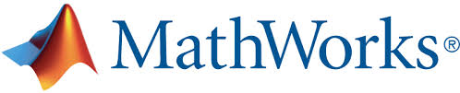
Automated Driving Systems - Co-Simulating Autoware with Simulink®
Group members:
Alperen Kıral
Daniyal Ahmed
Phuris Khunphakdee
Advisors:
Steve Schäfer (MathWorks)
Dr. Christoph Hahn (MathWorks)

Slide 2
Overview
Introduction
Functionalities of Autoware
Co-simulation
Progress
Future Work
Reference
2

Slide 3
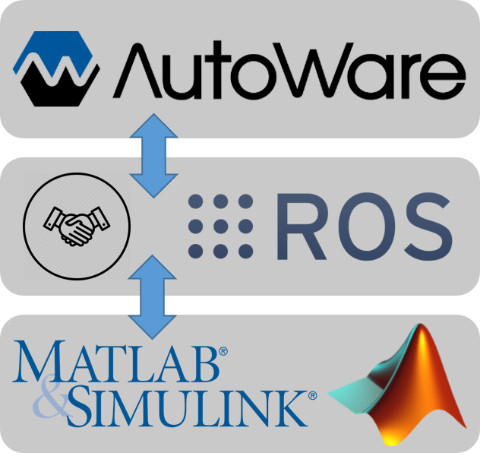
Introduction
The objectives of the project:
To connect Autoware to MATLAB and Simulink using Robotics System Toolbox for co-simulation
To develop an automated-driving co-simulation example
3

Slide 4
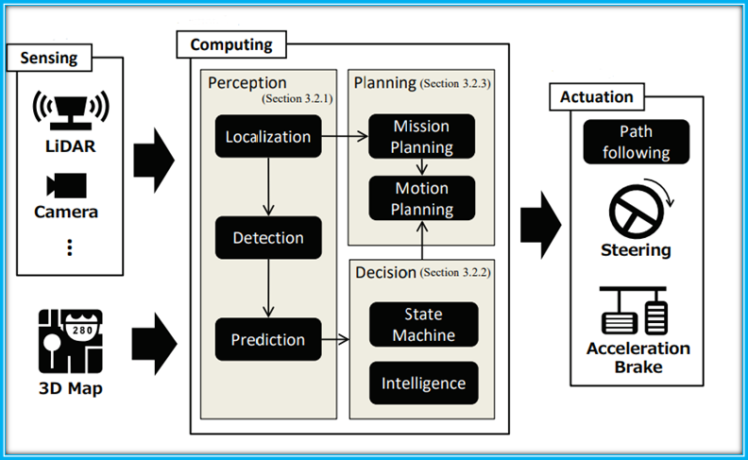
Introduction
Basic Control and Data Flow of Autonomous Vehicles:
Source: Kato, S., Tokunaga, S., Maruyama, Y., Maeda, S., Hirabayashi, M., Monrroy, A., . . . Azumi, T. (2018). Autoware on board: Enabling autonomous vehicles with embedded systems. Proc. of ICCPS 2018. 1-11. doi:10.1109/ICCPS.2018.00035
4
4

Slide 5
Functionalities of Autoware
Sensing Module Using Autoware:
SENSING
COMPUTING
ACTUATING
Autoware recognizes road environments from sensor input data
Sensing devices : LiDARS, cameras
Point Cloud Library (PCL)
Normal Distributions Transform (NDT) algorithm
5
5

Slide 6
Functionalities of Autoware
Computing module of Autoware:
LOCALIZATION
The localization algorithms implemented in Autoware exploit scan matching between 3D maps and LiDAR scanners
PREDICTION & DECISION
COMPUTING
MISSION & MOTION PLANNING
In Autoware, Kalman filters and particle filters are employed.
Autoware plans global trajectories based on the current location and final destination (lattice-based algorithms).
DETECTION
Autoware supports deep learning and machine learning approaches for object detection using Caffe and OpenCV
6
6

Slide 7
Functionalities of Autoware
Actuation Module:
PATH FOLLOWING
VEHICLE CONTROL
Pure pursuit algorithm to generate actuation commands for the vehicle
Filtered actuation commands control the vehicle
Actuation Module
7
7

Slide 8
Co-simulation
ROS and MATLAB/Simulink
ROS nodes in Autoware
Topic
ROS nodes from MATLAB/Simulink
Image Processing
Pedestrain Detection
Image
MATLAB
Sensors
Localization
Traffic Light Recognition
Publish
Subscribe
Subscribe
Camera
Traffic Light Recognition
Pedestrain Detection
Simulink
Actuators
Global Planning
Local Planner
Node
Node
Node
8
8

Slide 9
Co-simulation
Robotic System Toolbox
Robotic System Toolbox
MATLAB-ROS Interface
Simulink-ROS Interface
Test algorithm written in MATLAB in ROS robot or in simulators
Visualise and analyze data from ROS in MATLAB
Test algorithm written in Simulink in ROS robot or in simulators
Generate ROS nodes from algorithms developed in Simulink
Built-In Robotic Algorithm
Standard robotic algorithms
9
9

Slide 10
Co-simulation
Autoware Toolbox
Module | Node | Description | Matlab Code Support | Simulink Model Support
Detection | ACF Detector | Detecting people using aggregate channel features | ✔️ | ✔️
Localization | Vel Pose Connect | Determining the velocity and pose of the vehicle. | ✔️ | ✔️
Mission Planning | Lane Stop | Selecting waypoints according to the signal color | ✔️ | ✔️
Motion Planning | Path Select | Generating final waypoints from temporal waypoints | ✔️ | ✔️
10
10

Slide 11
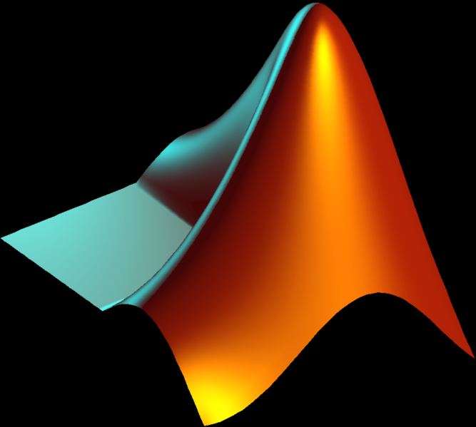



Progress
Required applications and tools:
11
11

Slide 12
Progress
Possible Operating System Configuration:
In order to speed up the progress:
Third configuration is selected
Autoware & Toolbox | MATLAB/Simulink &Toolbox
Linux (Virtual Machine) | Windows
Linux (Operating System) | Linux (Operating System)
Linux (Virtual Machine) | Linux (Virtual Machine)
12
12

Slide 13
Progress
Prior to installation of Autoware
Ubuntu & ROS Kinetic & QT
Autoware Two methods to install , two methods to build
Docker Catkin
Docker Colcon
Source Catkin
Source Colcon
13
13

Slide 14
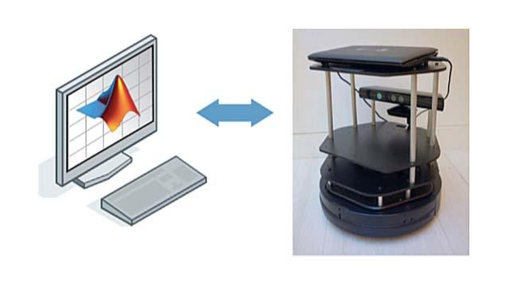
Progress
Matlab 2018b
Installation of Autoware Toolbox Sample Code Suit
Robotic System Toolbox is required
14
14

Slide 15
Future Work
Basic communication between Matlab & Autoware
Exploring the capabilities of Autoware Toolbox
Creating a very basic co-simulation demo
15
15

Slide 16
References
Autoware Documentation. (n.d.). Retrieved May 12, 2019, from https://buildmedia.readthedocs.org/media/pdf/autoware/feature-documentation_rtd/autoware.pdf
Kato, S., Tokunaga, S., Maruyama, Y., Maeda, S., Hirabayashi, M., Monrroy, A., . . . Azumi, T. (2018). Autoware on board: Enabling autonomous vehicles with embedded systems. Proc. of ICCPS 2018. 1-11. doi:10.1109/ICCPS.2018.00035
MATLAB/Simulink sample code suite for Autoware. (n.d.). Retrieved May 13, 2019, from https://github.com/CPFL/Autoware_Toolbox
Source Build. (2019, March 18). Retrieved from https://github.com/autowarefoundation/autoware/wiki/Source-Build
Tokunaga, S., Horita, Y., Oda, Y., & Azumi, T. (2019). IDF – Autoware: Integrated development framework for ROS-Based self-driving systems using MATLAB/Simulink. ASD 2019. doi:10.4230/OASIcs.ASD.2019.3
How to Open and Edit Files and Folders in Ubuntu Desktop as an Administrator. (n.d.). Retrieved May 13, 2019, from https://vitux.com/how-to-open-and-edit-files-and-folders-in-ubuntu-desktop-as-an-administrator/
16
16

